Slide 1

Vision Transformers
An Image is worth 16x16 words
Summer Internship- 2026
Name: Khushi Jha
Supervisor: Prof. Millie Pant
Mentor: Shubham Joshi Applied Mathematics & Scientific Computing
Indian Institute of Technology Roorkee

Slide 2

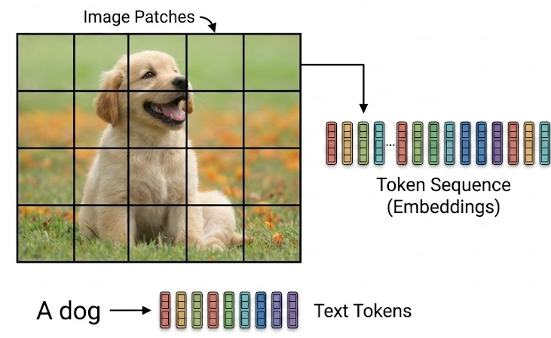
Introduction : Vision transformers
Transformers has become the de-facto standard for NLP, but was not mature for computer vision tasks ( by the time ViT was published)
To bridge this gap, the Vision Transformer proposes a radically simple idea: treat an image exactly like a sentence of text.
Instead of words, the image is divided into fixed-size patches, which are flattened and processed as a 1D sequence of tokens.

Slide 3
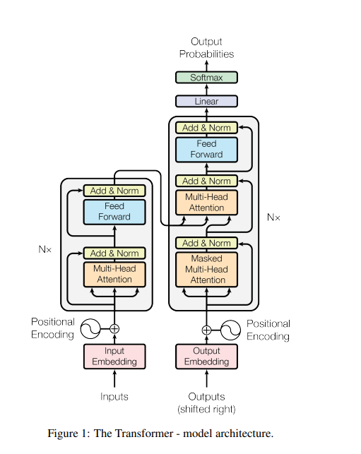
Origin : The NLP Transformers
ViT borrows its core architecture directly from the NLP world, specifically the famous "Attention is All You Need" paper.
This original architecture uses an Encoder-Decoder setup (shown left), relying on "Self-Attention" to learn how different parts of a sequence relate to each other
It processes data in parallel rather than step-by-step, using "Positional Encodings" (at the bottom) to remember the original order of the input.
The key difference: While standard NLP transformers need both halves for tasks like translation, ViT strips this down and uses only the Encoder (the left block) to process its image patches.

Slide 4
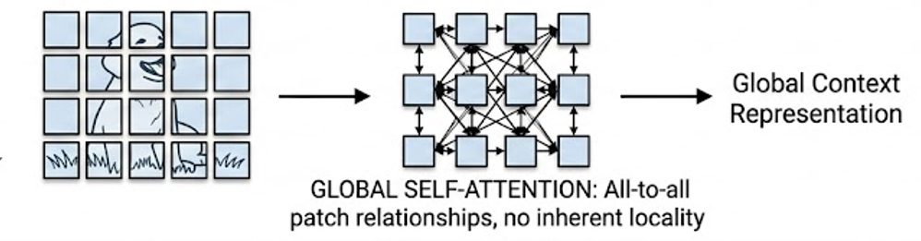
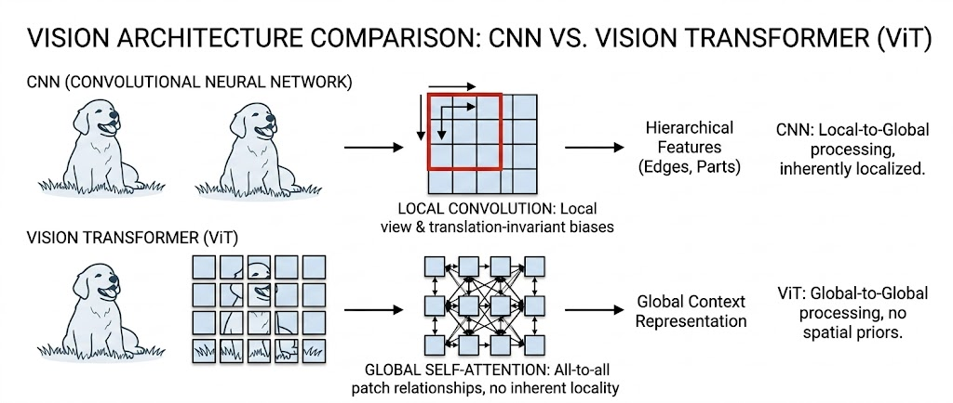

Vision Transformers v/s Convolutional Neural Network
Minimal inductive bias. Requires massive datasets to learn patterns from scratch, but has a higher accuracy.
Global receptive field. Uses self-attention to capture relationships across the entire image from the very first layer.
Computationally heavier (quadratic complexity as image size grows), but highly parallelizable for large-scale cluster training.
Strong inductive bias (assumes nearby pixels relate). Learns efficiently on small-to-medium datasets.
Local receptive field. Processes small areas first and builds global understanding slowly, layer-by-layer.
Hardware-optimized with a lighter memory footprint. The standard choice for real-time, low-latency edge devices.

Slide 5
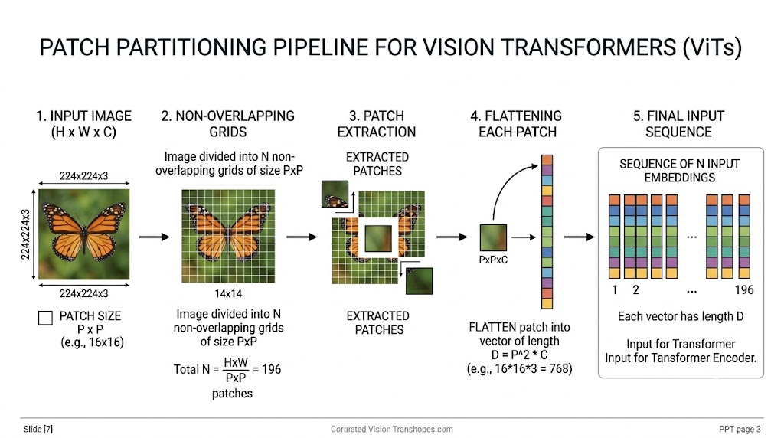

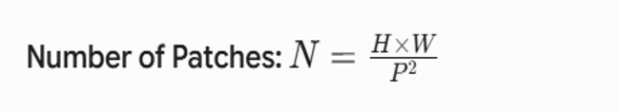
ViT: Patch Partitioning pipeline
ViT borrows its core architecture directly from the NLP world, specifically the famous "Attention is All You Need" paper.

Slide 6
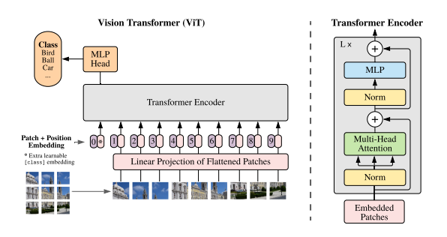
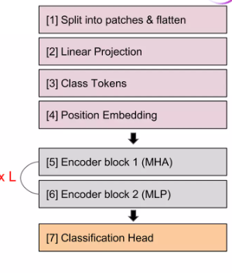
Vision Transformer Architecture
Position & Token embeddings
Transformer Encoder
Attention mechanism

Slide 7
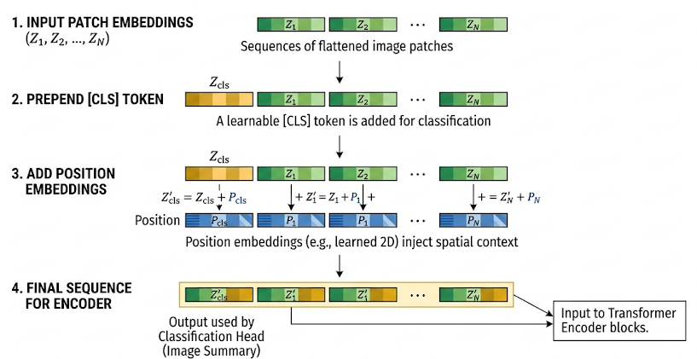
1. Position embedding & CLS Tokens
The Special [CLS] Token: A unique, learnable "Classification Token" ([CLS]) is prepended to the very front of the sequence. As it passes through the network, gathering context from all other patches to serve as the final "image summary" for prediction.
Positional Embeddings: Transformers process all tokens at once and inherently have no concept of order. To fix this, we mathematically add a specific "Position" vector to every token so the model remembers exactly where each patch belongs in the original 2D grid.
The Final Encoder Input: Once the [CLS] token is attached and the positional data is finalized, 1D sequence is officially ready to be fed into the Transformer Encoder blocks.

Slide 8
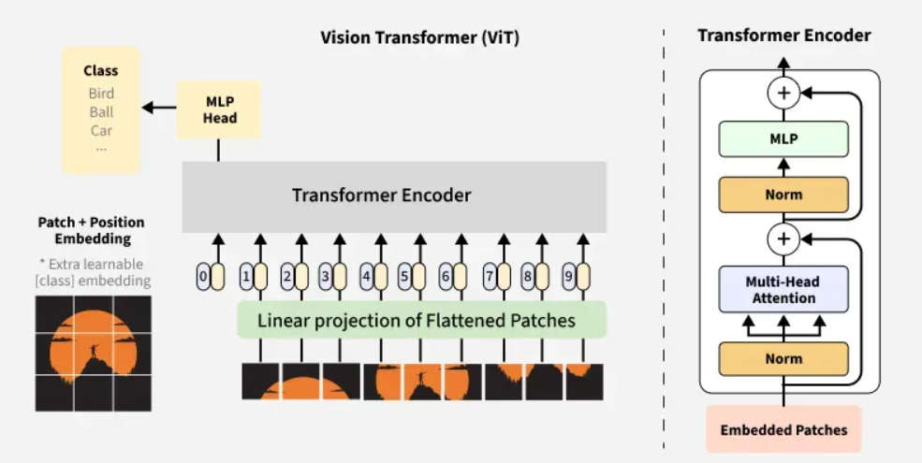
2. Transformer Encoder
Layer Normalization (LN): Applied before every block for stability.
Multi-Head Attention (MSA): Computes global dependencies.
Residual Connections: Facilitates gradient flow in deep networks.
MLP: Two linear layers with GELU non-linearity.

Slide 9
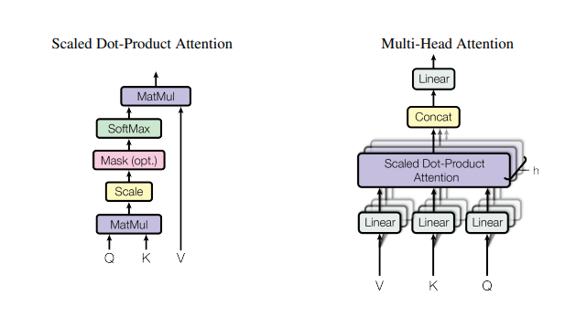

3. Self-Attention Mechanism
The Core Engine: ViT uses the exact same Multi-Head Self-Attention mechanism from the original NLP paper, relying on mathematical dot products rather than convolutions.
Defining Q, K, and V: For ViT, the Queries (Q), Keys (K), and Values (V) all come from the exact same place: our sequence of embedded image patches. This is why it is called Self-Attention.
Scaled Dot-Product: To find out how much "attention" Patch A should pay to Patch B, the model calculates the dot product of their Queries and Keys, scaling the result and applying a SoftMax function to create a probability score.
Why "Multi-Head"? Instead of computing attention just once, the model splits the process into multiple parallel "heads." This allows the network to simultaneously search for different visual relationships

Slide 10
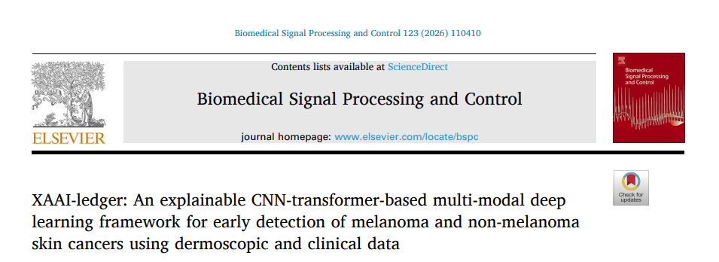
Beyond the Baseline ViT: What’s Next?

Slide 11
References
1. Attention is all you need : https://arxiv.org/pdf/1706.03762
2. An image is worth 16x16 words: transformers for image recognition at scale
https://arxiv.org/pdf/2010.11929

